Slide 1
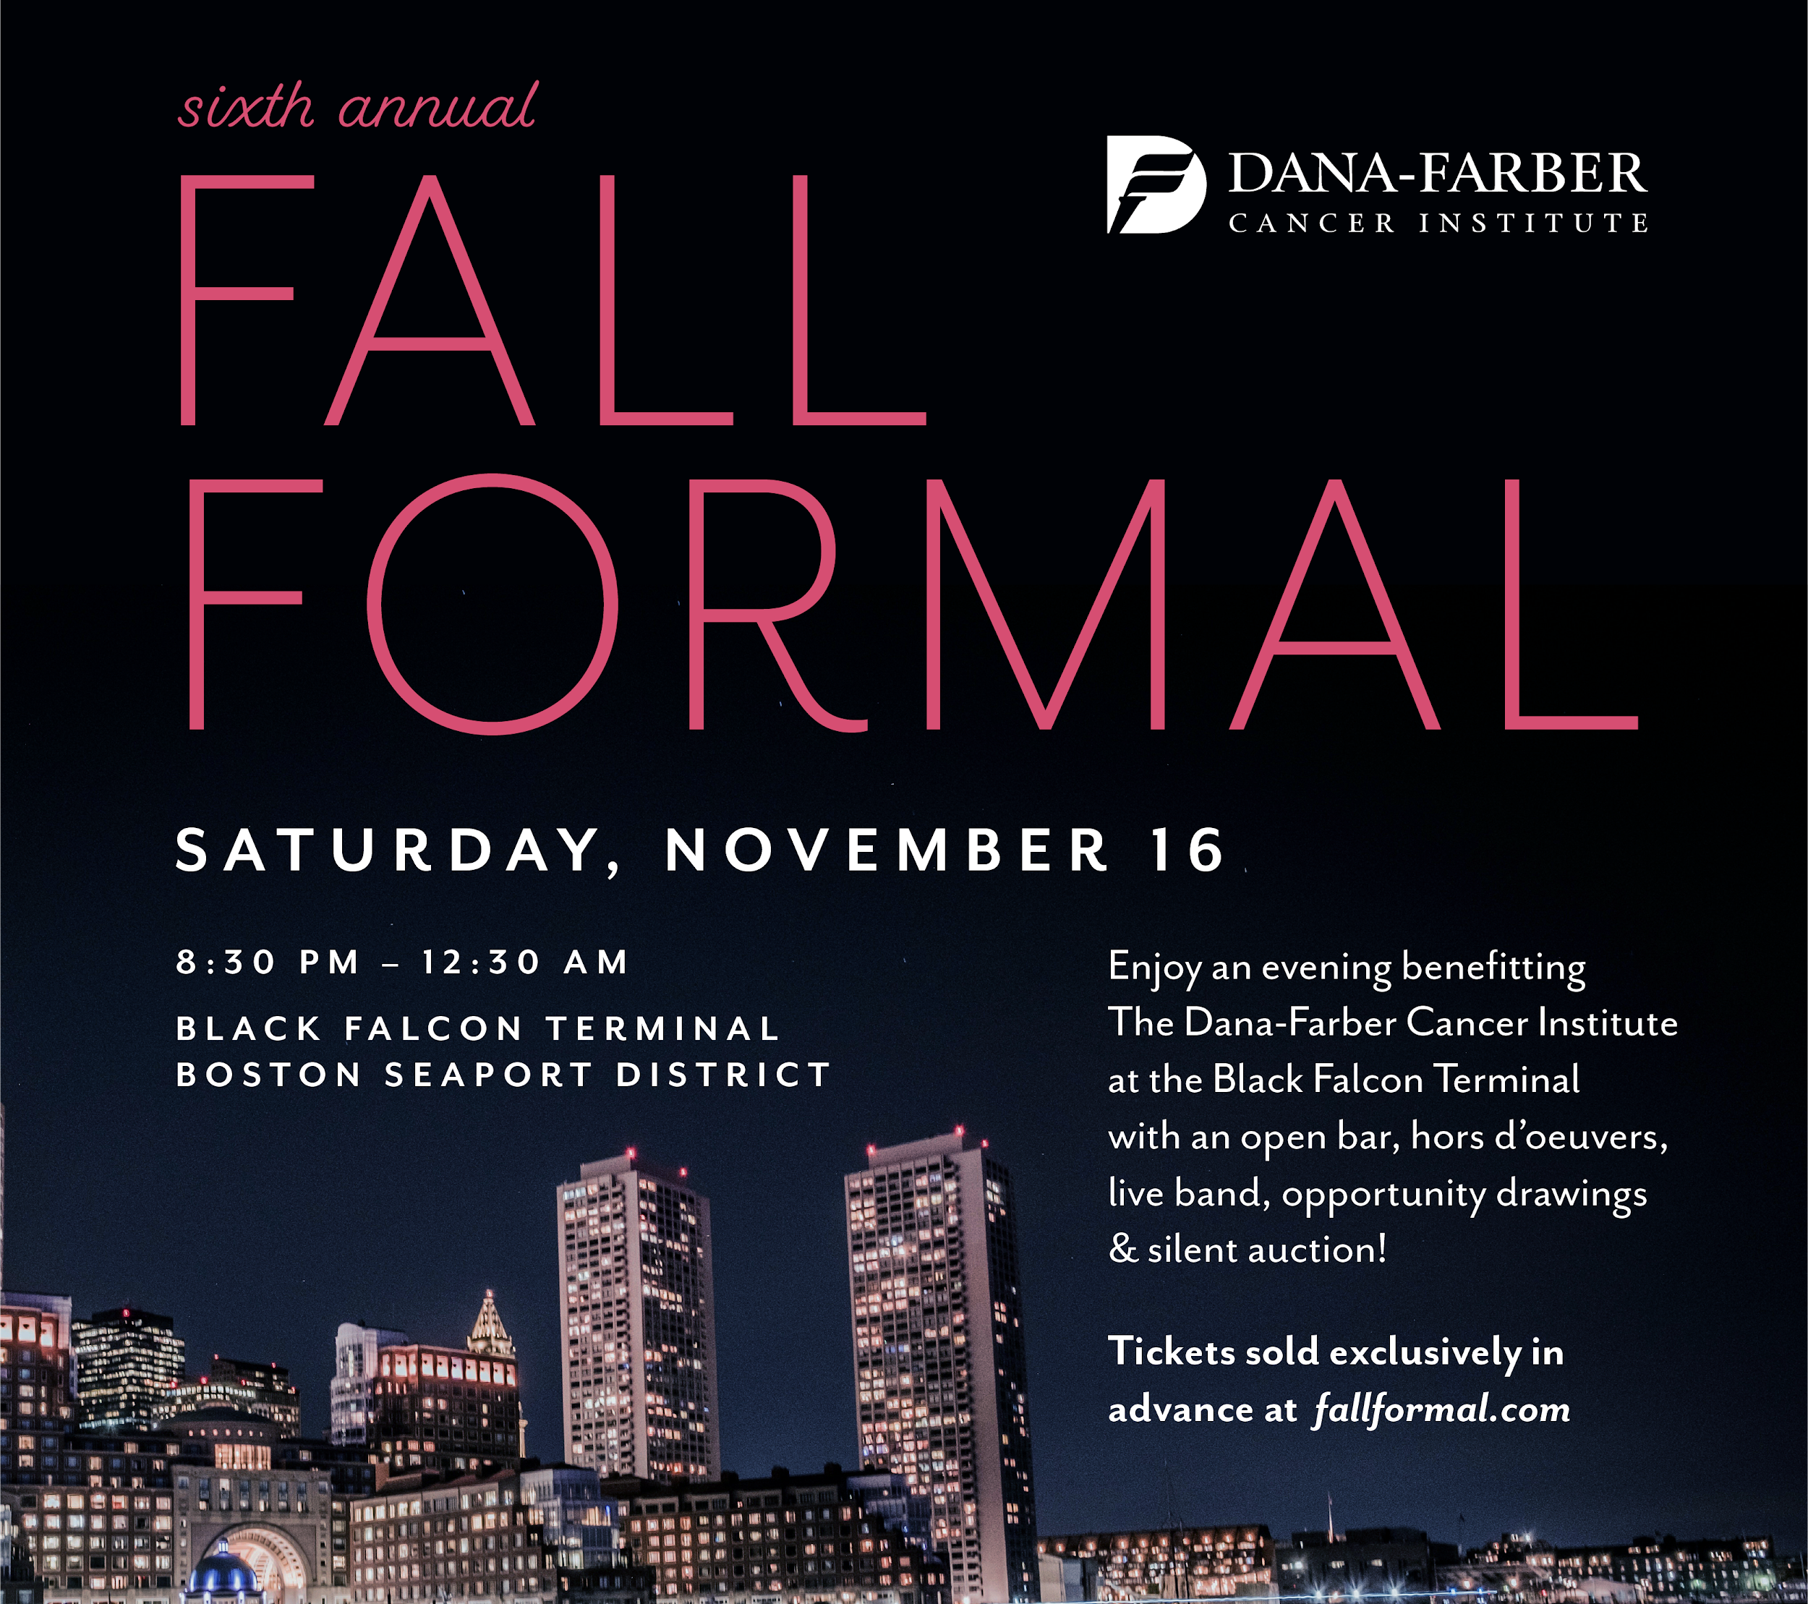
Since its founding in 1947, Dana-Farber has been committed to providing adults and children with cancer with the best treatment available today while developing tomorrow's cures through cutting-edge research.
Their equal commitment to research and patient care is unique among cancer centers and results in an extraordinary level of collaboration between our scientists and clinicians, speeding the translation of laboratory discoveries into lifesaving treatments for patients all over the world.

Slide 2
Starting in the Fall of 2014, the Fall Formal Fundraiser in Boston has established itself as an exciting event for local young professionals to come together in support of a great cause. With over $420,000 in funds donated to Dana-Farber Cancer Institute over the past four years, the 6th Annual Fall Formal aims to donate another $150,000 in 2019, but we need your help!
Your company has a unique opportunity to impact the fight against cancer by supporting the 6th Annual Fall Formal, benefitting Dana-Farber Cancer Institute.
Sponsorship Opportunities
Title Sponsor
Exclusive recognition as the presenting sponsor on all event materials, and in the title of the event
Recognition in all Fall Formal online materials including Fall Formal Website, Eventbrite, Facebook page (includes logo and text listing)
Acknowledgement as Title Sponsor in all email communications with attendees (logo and text listing)
Representation on photo backdrop (logo)
Representation in venue banners
Recognition on digital display screen throughout venue for the event’s raffle
Acknowledgment as presenting sponsor during mid-event announcement
15 complimentary tickets to the Fall Formal
$25,000
Corporate Sponsor
Recognition in all Fall Formal Online materials including Fall Formal Website, Eventbrite, Facebook page (includes logo and text listing)
Acknowledgement in all email communications with attendees (logo and text listing)
Representation on photo backdrop (logo)
Representation in venue banners
Recognition on digital display screen throughout venue for the event’s raffle
10 complimentary tickets to the Fall Formal
$10,000
Platinum Sponsor
Acknowledgement as sponsor for the event’s DJ/band and Open Bar Service
Recognition on Fall Formal website (text listing)
Acknowledgement in all email communications with attendees
Representation on photo backdrop (logo)
Recognition on digital display screen throughout venue for the event’s raffle
5 complimentary tickets to the Fall Formal
$5,000
Gold Sponsor
Recognition on Fall Formal website (text listing)
Acknowledgement in all email communications with attendees
3 complimentary tickets to the Fall Formal
$2,500
Silver Sponsor
Recognition on Fall Formal website (text listing)
2 complimentary tickets to the Fall Formal
Bronze Sponsor
Recognition on Fall Formal website (text listing)
1 complimentary tickets to the Fall Formal
$1,000
$500

Slide 3
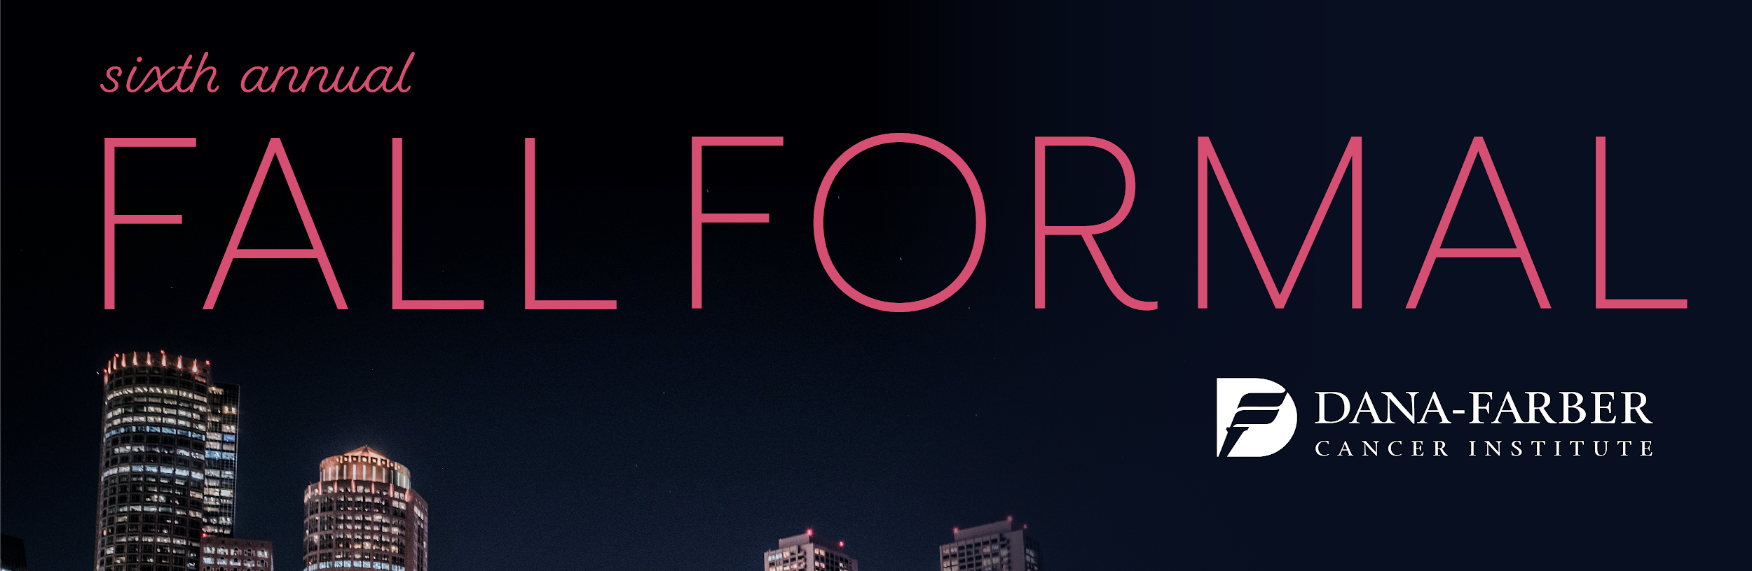
Reservation Form
Title Sponsor
Corporate Sponsor
Platinum Sponsor
Gold Sponsor
Silver Sponsor
Bronze Sponsor
Contribution of Your Choice
Please make checks payable to: “Fall Ball for Dana-Farber”
Please complete this form and send to: Attn: Jonathan Kazarian
25 Northern Ave, Apt 1616
Boston, MA 02210
I would like to be listed on print materials as follows: _________________________
Name: _________________________________________________________
Title: __________________________________________________________
Company: ______________________________________________________
Street: _________________________________________________________
City: ___________________________ State: __________ Zip: ___________
Telephone: _____________________________________________________
Email: _________________________________________________________
$25,000
$10,000
$5,000
$2,500
$1,000
$500
Dana-Farber Cancer Institute is a registered 501(c)(3) public charity with Federal Tax ID # 04-2263040. Contributions to Dana-Farber Cancer Institute are tax deductible, over and above the value of any goods and services received by the donor, to the extent provided by law.

Slide 4
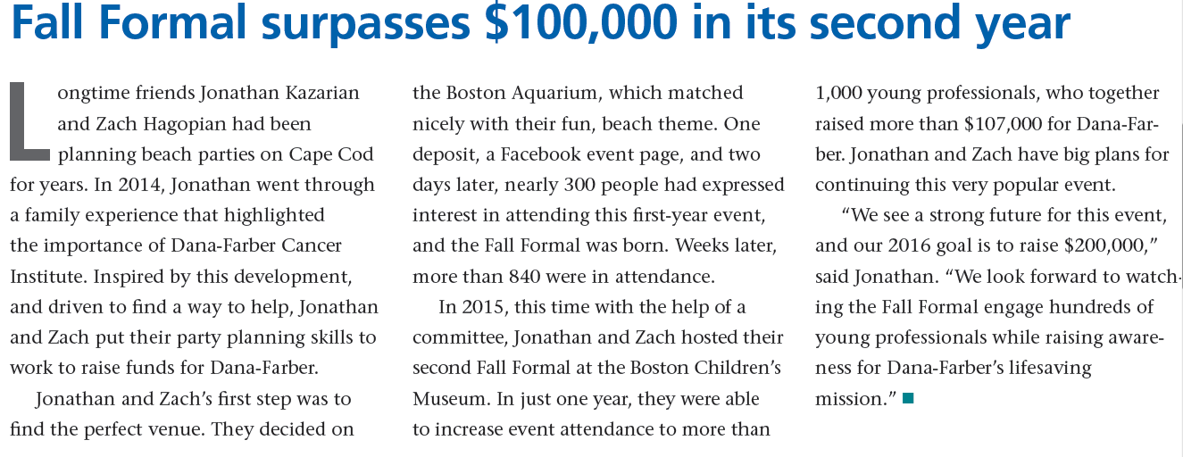
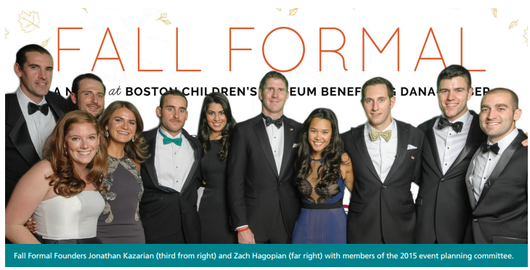

Slide 5
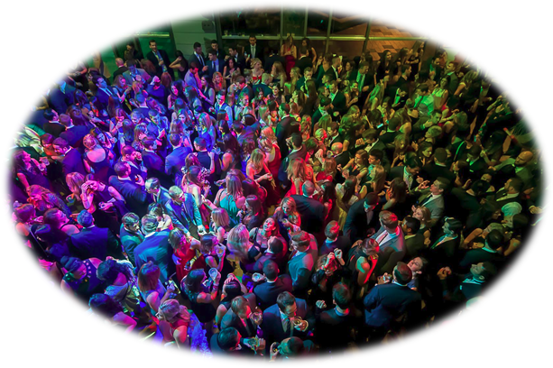
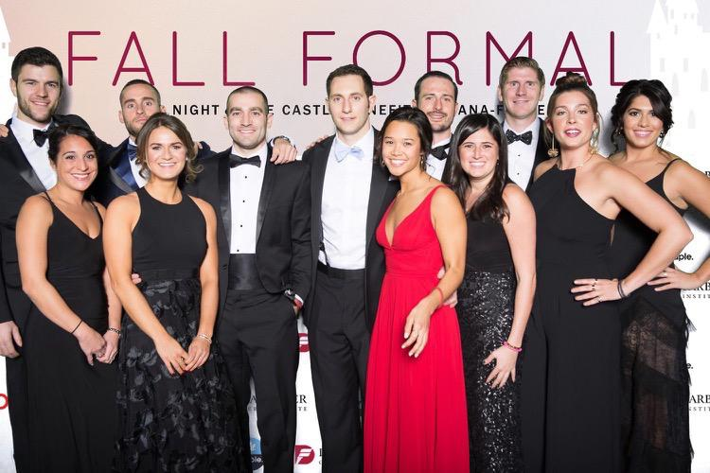
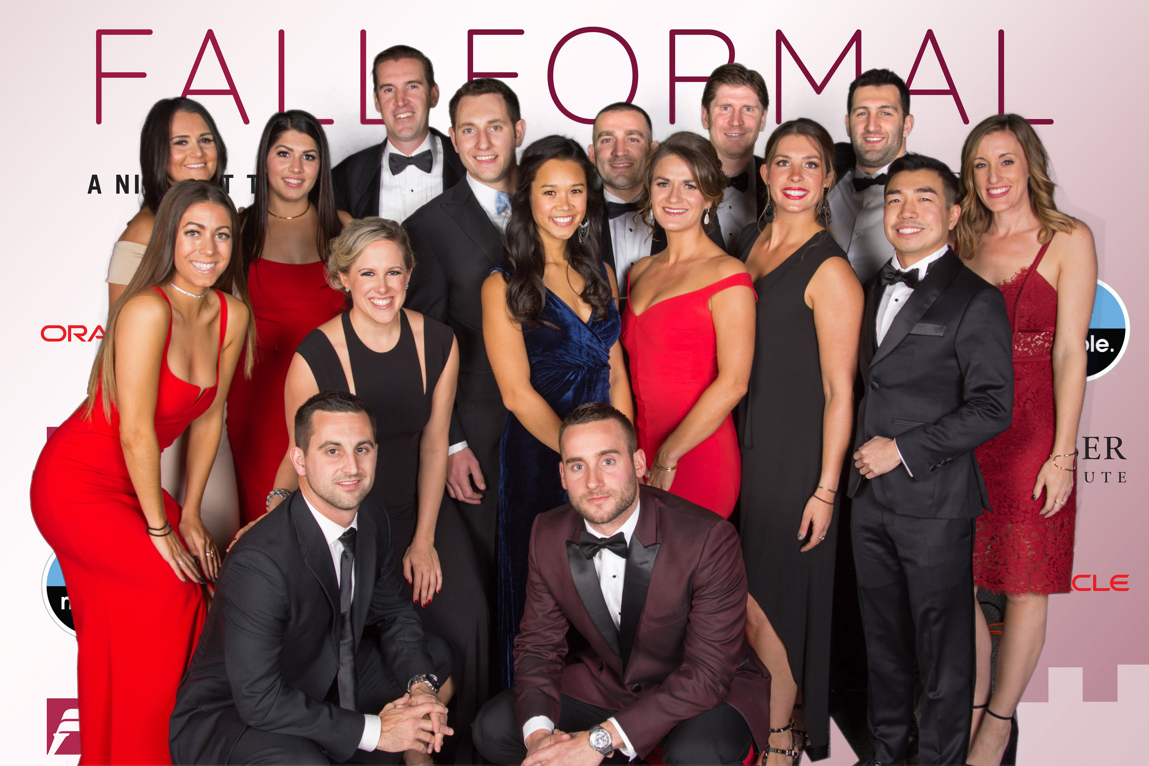
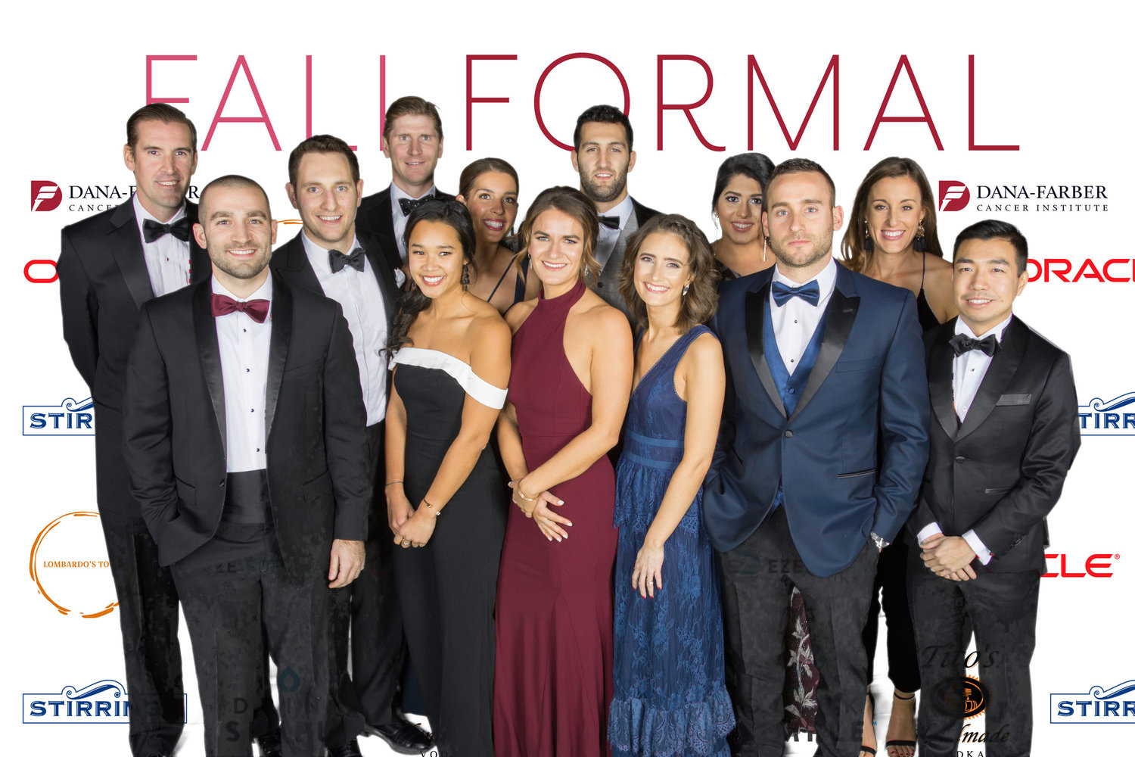
Fall Formal Sponsorship
Demographic Information
Engage Boston-Area millennials while a supporting a great event for an even better cause!
2015
2014
Attendance: 1,000 people
Average Age: 26 yrs old
2016
Attendance: 1,000+ people
Average Age: 27 yrs old
2017
2018
Attendance: 800+ people
Average Age: 27 yrs old
Attendance: 800+ people
Average Age: 28 yrs old
Please contact any of our committee members for more information:
Alex Kazarian
Anne Maroun
Ben Price
Brianna Cole
Brittany Yu
Carley Hayes
David Grotz
David Lombardo
Deanna Eng
Derek Lo
gmlynch18@gmail.com
jeffsayman@gmail.com
jon.kazarian@gmail.com
calvo.kristen@gmail.com
mhhoban1@gmail.com
madelyn.maroun@gmail.com
weiler.meghan@gmail.com
nbhensler@gmail.com
hagopiaz@gmail.com
alex.kazarian10@gmail.com
amaroun14@gmail.com
ben.price.g@gmail.com
briannacole27@gmail.com
brittany.yu518@gmail.com
carleylhayes@gmail.com
dgrotz24@gmail.com
david@lombardos.com
dseng90@gmail.com
lerekdo@gmail.com
Grace Lynch
Jeff Sayman
Jonathan Kazarian
Kristen Calvo
Matt Hoban
Madelyn Maroun
Meghan Weiler
Nicole Hensler
Zach Hagopian

